Slide 1

DBMS LAB
KCS-551
Database Management System Lab
VIKRANT MALIK
RAM KUMAR SHARMA
(Department of Information Technology)
NOIDA INSTITUTE OF ENGINEERING AND TECHNOLOGY
GREATER NOIDA

Slide 2
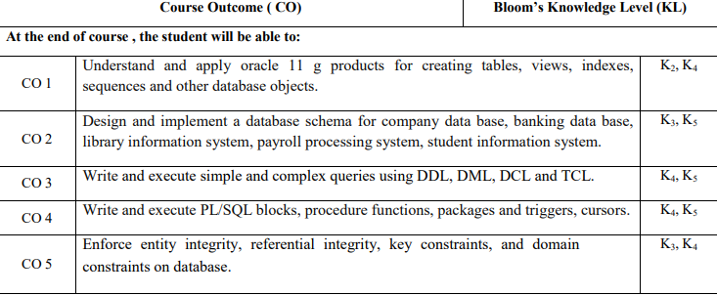
Database Management System Lab

Slide 3
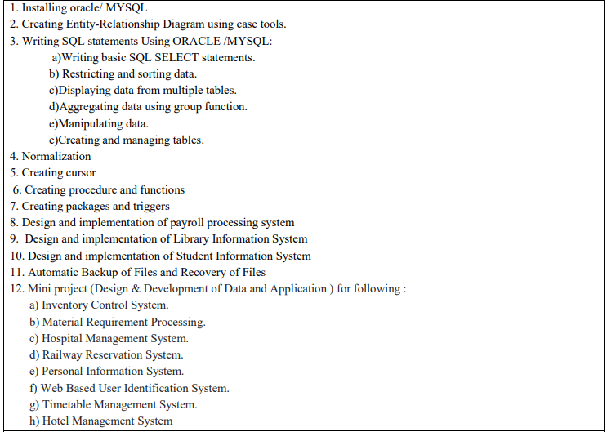
DBMS Lab Programs List

Slide 4
Program 1. Installation of Oracle 11g.
Lab-1:-Installation of oracle 11G.

Slide 5
Program 1. Installation of Oracle 11g.
Download the setup of Oracle 11g and double click.
Then
1. Select installation method
Following two installation methods are available:
Basic Installation – Choose this to perform the full Oracle Database 11g installation with standard configuration options. You can use only filesystem for storage in this option.
Advanced Installation – This gives your full control over the installation, including the ability to choose Automatic Storage Management. Select this option as shown below.

Slide 6
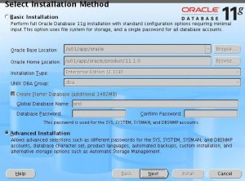
Continue
Fig – Select Installation Method

Slide 7
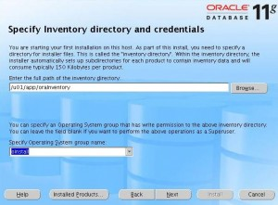
Conti…
2. Specify Inventory directory and credentials
Enter the following information:
Enter the inventory directory: /u01/app/oraInventory
Specify operating system group name: oinstall
Fig – Specify Inventory directory and credentials

Slide 8
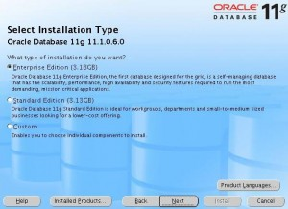
Conti...
3. Select Installation Type
Following three installation types are available:
Enterprise Edition – Select this option.
Standard Edition
Custom
Fig – Select Installation Type

Slide 9
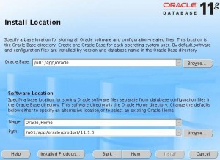
Conti...
4. Specify Install Location
Enter the following information:
Oracle Base: /u01/app/oracle
Name: Oracle_Home
Path: /u01/app/oarcle/product/11.1.0

Slide 10
Conti...
5. Product-Specific Prerequisite Checks
In this screen, the Installer verifies that your environment meets all of the minimum requirements for installing and configuring the products that you have chosen to install. You must manually verify and confirm the items that are flagged with warnings and items that require manual checks.

Slide 11
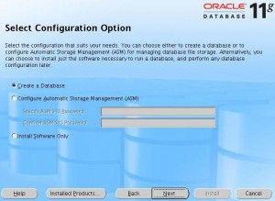
Conti...
6. Select Configuration Option
Following three configuration options are available:
Create a Database – Select this option.
Configure Automatic Storage Management (ASM)
Install Software Only

Slide 12
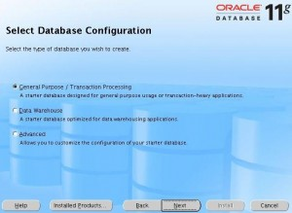
Conti...
7. Select a Database Configuration
Following three database configuration options are available.
General Purpose/Transaction Processing – Select this option.
Data Warehouse
Advanced

Slide 13
Conti...
8. Specify Database Configuration
Enter the following information:
Global Database Name: devdb.example.com . An Oracle database is uniquely identified by a Global Database Name, typically of the form “name.domain”
SID: devdb

Slide 14
Conti...
9. Specify Database Configuration Details
There are four different tabs in this screen as shown below:
Memory Tab
  Select the check-box to Enable Automatic Memory Management
  Drag the bar to allocate the memory. This will automatically allocate memory size for SGA and PGA depending on the total database memory allocated.
Character Sets Tab. Following three character set options are given in this tab.
  Use the default
  Use Unicode (AL32UTF8)
  Choose from the list of character sets. Select Database Character Set as Unicode standard UTF-8AL32UTF8 – Select this option.
Security Tab – Just leave the defaults in this tab.
Sample Schema Tab – Just leave the defaults in this tab.

Slide 15
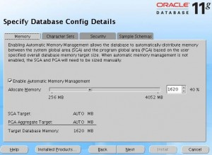
Conti...
. Fig Specify Database Configuration Details

Slide 16
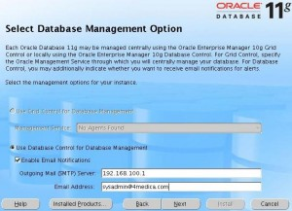
Conti...
10. Select Database Management Option
Following two management options are available:
Use Grid Control for Database Management
  Management Service: Choose an agent.
Use Database Control for Database Management- Select this option.
  Select the check-box to Enable Email Notifications
  Outgoing mail (SMTP) Server:
  Email Address:

Slide 17
Conti...
11. Specify Database Storage Option
Following two storage options are available:
File System – Select this option.
  Specify Database File location: /u01/app/oracle/oradata/
Automatic Storage Management. ASM simplifies database storage administration and optimizes database layout for I/O performance.

Slide 18
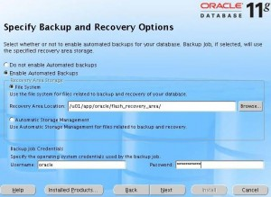
Conti...
12. Specify Backup and Recovery Option
Enable automated backup as shown below. If you’ve configured ASM, you can choose to store the automated backups on ASM. If not, select File System option.

Slide 19
Conti...
13. Specify database schema password
Enter the password for sys, system, sysman, dbsnmp schemas. You have the option of either using the same passwords or different password for all the accounts in this screen.
14. Privileged Operating System Groups
Enter the following information in this screen:
Database Administrator (OSDBA) Group: dba
Database Operator (OSOPER) Group: dba
ASM administrator (OSASM) Group: db

Slide 20
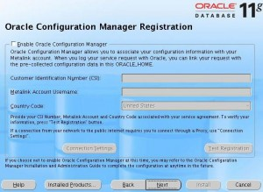
Conti...
15. Oracle Configuration Manager Registration
You can associate your configuration information with your metalink account as shown below.

Slide 21
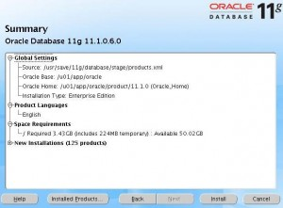
Conti...
16. Final Summary Screen
This will display a summary of all the installation option you’ve selected so far. Click on Install to complete the installation.

Slide 22
Conti...
Oracle 12 c installation link
https://www.oracletutorial.com/getting-started/install-oracle/
My Sql Download & installation
https://slideplayer.com/slide/2626698/

Slide 23
Program 2. Creating Entity Relationship Diagram using case tool..
Lab-2
Program 2:- Creating Entity Relationship Diagram using case tool.

Slide 24
Program 2
Program 2:- Creating Entity Relationship Diagram using case tool.
Consider the database of an online bookstore.
Every book has a title, isbn, year and price. The store also keeps the author and publisher for any book.
For authors, the database keeps the name, address and the url of their homepage.
For publishers, the database keeps the name, address, phone number and the url of their website.
The store has several warehouses, each of which has a code, address and phone number.
The warehouse stocks several books. A book may be stocked at multiple warehouses. (In previous sentence, we are not referring to a particular copy of the book. Consider for example “the complete book” for our course. This book may be stocked at multiple warehouses.)

Slide 25
Continue
Program 2:- Creating Entity Relationship Diagram using case tool.
The database records the number of copies of a book stocked at various warehouses.
The bookstore keeps the name, address, email-id, and phone number of its customers.
A customer owns several shopping basket. A shopping basket is identified by a basketID and contains several books.
Some shopping baskets may contain more than one copy of same book. The database records the number of copies of each book in any shopping basket.

Slide 26
Conti...
STEP 1:- Identify all the entities
-AUTHOR
-PUBLISHER
-BOOK
-CUSTOMER
-SHOPPING_BASKET
-WAREHOUSE

Slide 27
Conti...
Step 2:-Identify the relationship
1.Each book is written by a author
2.Each book has a publisher
3. Some shopping baskets may contain more than one copy of same book
4. The warehouse stocks several books
5. A customer owns several shopping basket

Slide 28
Conti...
Step 3:- Identify the key attribute
AUTHOR- name
PUBLISHER- name
BOOK- ISBN
CUSTOMER- email
SHOPPING_BASKET- basket_ID
WAREHOUSE- code

Slide 29
Conti...
4. Identify other relevant attributes
AUTHOR- name,address,URL
PUBLISHER- name,address,URL,phone
BOOK- ISBN,year,title,price
CUSTOMER- email, name,address,phone
SHOPPING_BASKET- basket_ID
WAREHOUSE- code, address,phone

Slide 30
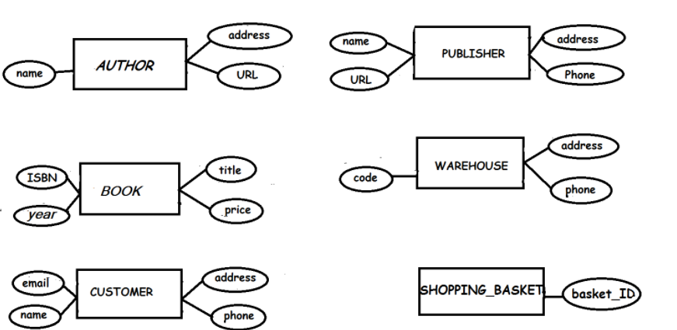
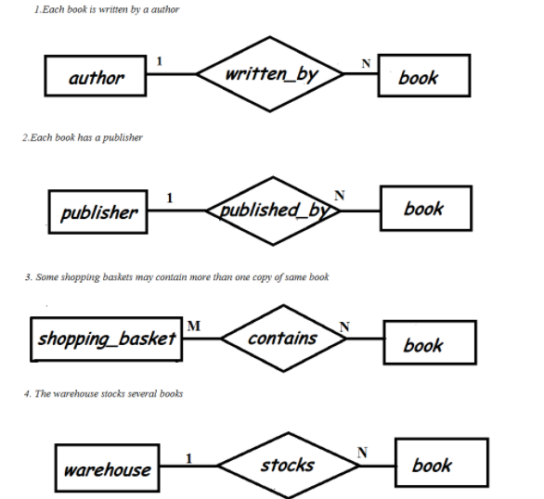
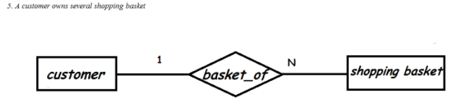
Conti...

Slide 31
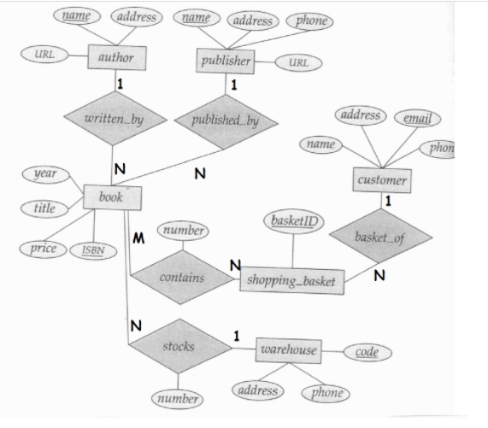
Conti...

Slide 32
Introduction of Database
DATABASE
A database is a collection of Data (Information). Examples of databases, which we use in our daily life, is an Attendance Register, Telephone Directory, Muster Roll.
DBMS
Database Management System(DBMS): A database management system is a collection of programs written to manage a database. That is, it acts as a interface between user and database.
RDBMS
A Database Management System based on Relational Data Model is known as Relational Database Management System (RDBMS).
Relational Data Model was developed by Dr. E.F. CODD. He developed the relational data model by taking the concept from Relational Algebra in June - 1970.
Relational Data Model has some 12 Rules which are named after Codd as Codd Rules. According to Codd a package can be called as RDBMS only if it satisfies the Codd Rules.

Slide 33
Introduction SQL
What is SQL?
SQL stands for Structured Query Language It is a computer language that provide an interface to relational database system.SQL was developed by IBM in the 1970 for use in R System.(SEQUEL which stands for Structured English Query Language for their RDBMS.).
SQL is both an ISO and an ANSI (American National Standards Institute) standard.
What Can SQL do?
SQL can execute queries against a database
SQL can retrieve, insert, update, delete data from a database
SQL can create new databases
SQL can create new tables in a database
SQL can create stored procedures in a database
SQL can create views in a database
SQL can set permissions on tables, procedures, and views

Slide 34
Structure Query Language
SQL language is divided into five types of primary language statements: DML, DDL, DCL,TCL and DQL. Using these statements, we can define the structure of a database by creating and altering database objects, and we can manipulate data in a table through updates or deletions. We also can control which user can read/write data or manage transactions to create a single unit of work.
The Five main categories of SQL statements are as follows:
1. DDL (Data Definition Language)
2. DML (Data Manipulation Language)
3. DCL (Data Control Language)
4. TCL (Transaction Control Language)
5. DQL (Data Query Language)

Slide 35
Common Rules for SQL Commands/Statements
SQL statements are not case sensitive. It can be typed in lower case or upper case or mix of both.
The statements can be typed in a single line or multiple lines.
A semicolon is placed to terminate the SQL statements
The Keywords can’t be distributed across the line but statements may be.
A comma(,) is used to separate parameter without a clause.
Characters and Date Constants or literals must be enclosed in single quotes(‘A’).
A command can be type either full or first 4 characters generally.
Reserve words cannot be used as identifiers unless enclosed with double quote.
Identifier can contain up to 30 characters and must start with an alphabetic character.

Slide 36
1. DATA DEFINITION LANGUAGE
Data Definition Language (DDL) DDL statements are used to alter/modify a database or table structure and schema. These statements handle the design and storage of database objects. DDL Command by default are auto commit.
DDL statements include the following :
CREATE - to create objects in the database
ALTER - alters the structure of the database
DROP - delete objects from the database
TRUNCATE - remove all records from a table, including all spaces allocated for the records are removed
COMMENT - add comments to the data dictionary
RENAME - rename an object

Slide 37
2. DATA MANIPULATION LANGUAGE
Data Manipulation Language (DML) DML statements affect records in a table. These are basic operations we perform on data such as selecting a few records from a table, inserting new records, deleting unnecessary records, and updating/modifying existing records.
DML statements include the following:
INSERT - insert data into a table
UPDATE - updates existing data within a table
DELETE - deletes all records from a table, the space for the records remain
MERGE - UPSERT operation (insert or update)
CALL - call a PL/SQL or Java subprogram
EXPLAIN PLAN - explain access path to data
LOCK TABLE - control concurrency

Slide 38
3. DATA CONTROL LANGUAGE
Data Control Language (DCL) ,DCL statements control the level of access that users have on database objects statements.
DCL statements include the following
GRANT - gives user's access privileges to database
REVOKE - withdraw access privileges given with the GRANT command

Slide 39
4. TRANSACTION CONTROL LANGUAGE
Transaction Control (TCL) statements are used to manage the changes made by DML statements. It allows statements to be grouped together into logical transactions. TCL statements allow you to control and manage transactions to maintain the integrity of data within SQL statements.
TCL statements include the following
COMMIT - save work done
SAVEPOINT - identify a point in a transaction to which you can later roll back
ROLLBACK - restore database to original since the last COMMIT
SET TRANSACTION - Change transaction options like isolation level and what rollback segment to use

Slide 40
5. DATA QUERY LANGUAGE
Data Query Language (DQL), The commands of SQL that are used to retrieve data from the database are collectively called as DQL. So all Select statements comes under DQL.
DQL statement include the following
Select: To retrieve data from the database table.

Slide 41
KEYWORD AND DATA TYPES
SQL have approximate 107 reserve words(Keywords).
Data type come in several forms and sizes, allowing the programmer to create table suited to the scope of the project. Some of common data types are used
S No. | Data Type | Description | Range
1 | Char(size) | Used for to store character string values of fixed length | 255 character
2 | Varchar(Size) | Store Alphanumeric data | Hold upto 4000 characters
3 | Varchar2(Size) | The string value's length will be stored on disk with the value itself.(Inserted value not be padded with space) | Hold upto 4000 characters
4 | Date & Time |  | DD-MON-YYYY
5 | Number | Store Numbers(Fixed or Floating point)
6 | LONG | Store variable length characterString | Upto 2 GB.

Slide 42

Program 3. DDL,DML,DCL etc commands
Lab-3
Program 3 :- Understood about SQL, and Implementation of DDL,DML,DQL and DCL command

Slide 43
Program 3. DDL,DML,DCL etc commands
Content
Commands
Create
Insert
Select
Update
Delete
Commit
Rollback
Alter
Rename
Truncate
Drop

Slide 44
CREATE TABLE
Create table command
Syntax: Create table <TableName> (<Columnname 1> <Datatype> (<size>),………………, (<Columnname N> <Datatype> (<size>));
The Column Specification includes –
  column name
  data type
  [size or length of column] //[] means optional
  [constraints] // [] means optional
Displaying table structure
Syntax: Desc <TableName>
Or
Describe <TableName>

Slide 45
QUERIES:
Q1. Create a table called Student with the following structure.
Roll No | S_NAME | Branch | Age

Slide 46
2. DML COMMANDS
INSERT COMMAND
Inserting a single row into a table:
Syntax: insert into <table name> values (value list)
Example: insert a row into Student table.
Inserting a single row into a table with particular columns:
Syntax: insert into <table name> (<columnname1>,<columnname2>) values (<experssion1>,<expression2>)
Example: insert a row into Student table.
Inserting more than one record using a single insert commands:
Syntax: insert into <table name> values (&col1, &col2, ….)
Example: Insert 5 rows into Student table,

Slide 47
QUERIES:
Q1. Create a table called Student with the following structure.
Roll No | S_NAME | Branch | Age
17133001 | Arpit | IT | 19
17133002 | Mohit | CS | 20
17133003 | Apeksha | IT | 18
17133004 | Shubham | IT | 17
17133007 | Vishal | CMC | 21

Slide 48
VIEWING DATA IN THE TABLE
Viewing data in the table
All row and all column
Syntax: SELECT * from <TableName>;
EXAMPLE: Select * from Student;
Filtering table data
Selected column and all rows
Syntax: SELECT <columnname1>,<columnname2> from <table>;
Selected row and all columns
Syntax: SELECT * from <tablename>where <condition> ;
Selected columns and selected Rows
Syntax: SELECT <columnname1>,<columnname2> from <table>where <condition> ;

Slide 49
Examining objects created by user
Syntax: SELECT * from tab;

Slide 50
UPDATE
Updating the contents of a table
Updating all rows
Syntax: Update <TableName> set <ColumnName1> = <expression 1>, <ColumnName2>=<expression2>;
Example: Update the student table by changing the Age to ‘19’, for all students.
Sql Query :- UPDATE STUDENT SET =19;
Updating rows conditionally
Syntax: Update <TableName> set <ColumnName1> = <expression 1>, <ColumnName2>=<expression2> where <Condition>;
Example: Update the student name Vishal with branchname by IT.

Slide 51
DELETE
Delete operations
Removal of all rows from table
Syntax: Delete from <TableName>;
Or
Delete <TableName>;
Removal of specific rows
Syntax: Delete from <TableName> where <condition>;

Slide 52
SELECT COMMANDS
Elimination of duplicates from the select clause:
It prevents retrieving the duplicated values ,Distinct keyword is to be used.
Syntax: Select DISTINCT col1, col2 from table name;
Example: Select DISTINCT Branch Name from Student;
Sorting Data in a table
It sorts the result set based on columns specified.
Syntax: Select column_name1, …..,column_nameN from table name where condition order by colmnname;
Example:i)
Select sname from student order by rollno;
ii)Sort the table in descending order of age .
Syntax : Select * from student order by age desc;

Slide 53
SELECT COMMANDS
Select command to create a table:
Syntax: create table tablename as select * from existing_tablename;
Example: create table student1 as select * from student;
CREATE TABLE new_table AS (SELECT column_1, column2, ... column_n FROM old_table);
CREATE TABLE employee_IT AS (SELECT * FROM student WHERE rollNo> 17133001);
CREATE TABLE new_table AS (SELECT column_1, column2, ... column_n FROM old_table_1, old_table_2, ... old_table_n)

Slide 54
SELECT COMMANDS
Question
How can I create a SQL table from another table without copying any values from the old table?
CREATE TABLE new_table AS (SELECT * FROM old_table WHERE 1=2);

Slide 55
ALTER COMMANDS
Modifying structures of tables
Adding new columns
Alter table <TableName> add (<NewColumnname 1> <Datatype> (<size>), (<NewColumnname 2> <Datatype> (<size>),………………, (<NewColumnname M> <Datatype> (<size>));
Dropping a column from a table
Alter table <TableName> drop column <columnName>;
Modifying existing columns
Alter table <tablename> Modify (Columnname> <NewDatatype> (<Newsize>))

Slide 56
RENAMING,TRUNCATING,DESTROYING COMMANDS
Renaming tables
Rename <TableName> to <NewTableName>;
Truncating tables
Truncate table <TableName>;
Destroying tables
drop table <TableName>;

Slide 57
EXERCISE-1
1. Create table emp with attributes
1. Emp_no <datatype><size>
2. E_name <datatype><size>
3. JOB <datatype><size>
4. Address <datatype><size>
2. Insert data into the table

Slide 58
EMP
EMP_NO | E_NAME | JOB | ADDRESS
1001 | Arpit | AP | NOIDA
1002 | Mohit | AP | DELHI
1003 | Apeksha | AP | GR. NOIDA
1004 | Shubham | Lecture | NOIDA
1002 | Anchal | AP | DELHI
1006 | Ramesh | Peon | DELHI
1007 | Vishal | Manager | NOIDA

Slide 59
EXERCISE
3. Select Address, ename from emp working as peon.
4. Select distinct job from emp.
5. Select e_name from emp ascending and descending order
6. Update apeksha job as a HOD .
7. Describe all table.
8. Delete employee arpit from table emp.
9. Add a column salary in emp.
10. Drop a column salary from emp.
11. Modify existing column ename with name in emp.
12. Create table emp123 from table emp with record.
13. Create table emp12 from emp without populated any record.
14. Rename table emp to employee123.
15.Delete all record from emp.
16. Drop structure of emp.

